Slide 1


R ‘N T HEALTHCARE ASSISTANT

Slide 2





R ‘n T Medical Healthcare assistant
ABOUT US
We are R ‘n T. We are a medical assistant service. The program we have made assists every age group. We have put a lot of work and effort into making this program.
We find it quite enthralling to delve into the technical and scientific world of medicine. As we adore coding and are lovers of Science, we found this the perfect opportunity to exhibit our talent and let our inner feelings shine!

Slide 3
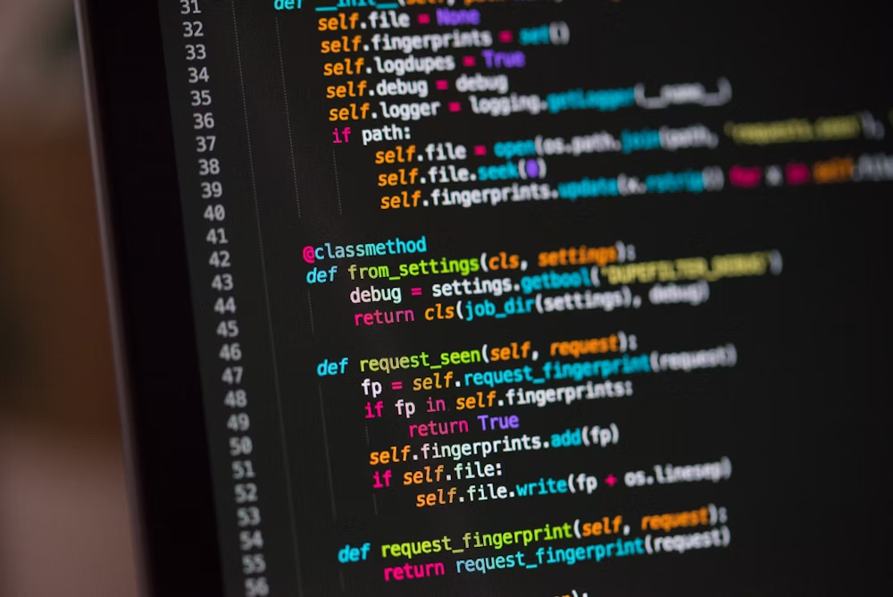
R ‘n T Medical Healthcare assistant
ABOUT OUR PROJECT
01
This healthcare assistant would keep you fit and healthy.
02
We have diligently inculcated ways in which you can gain deeper understanding of your health.
03
It allows you to explore a plethora of healthy recipes you can cook. It also provides insights into your health status, including your weight evaluation by providing your BMI

Slide 4

R ‘n T Medical Healthcare assistant
HOW IT WORKS
01
You enter your health status - Healthy, Sick, or Very Sick.
02
You will get the recipes according to your health status.
03
After suggesting some recipes, you will be offered the BMI calculator that allows you to calculate your BMI and tells you whether your weight is underweight, normal, overweight, or obese

Slide 5


R ‘n T Medical Healthcare assistant
THANK YOU
CREDITS
Ranteg Singh
Tanmay Modi

